Slide 1
Customer Personality Analysis
Chunpeng Wang
Mengyu Zhao
Xinrou Zhou

Slide 2
Data Description
Detailed analysis of a company’s ideal customers (27 features)
-> help company to modify products for specific customers
-> help business
For example, if company are able to segment customers
-> instead of spending money to market a new product to every customer in the company’s database, a company can analyze which customer segment is most likely to buy the product and then market the product only on that particular segment.

Slide 3
Variable description
We can roughly categorized variable as 4 higher level group to describe the data
People(Age, marital status, kids number…)
Product(Amount of spend on each product category last 2 year…)
Promotion(number of deals using promotion)
Places(where did customer purchases, online or in store)

Slide 4
Project Goal
Goal: perform clustering to summarize customer segments.
OUTLINE:
Data cleaning
Data initial analysis(exploratory data analysis)
Data segmentation

Slide 5
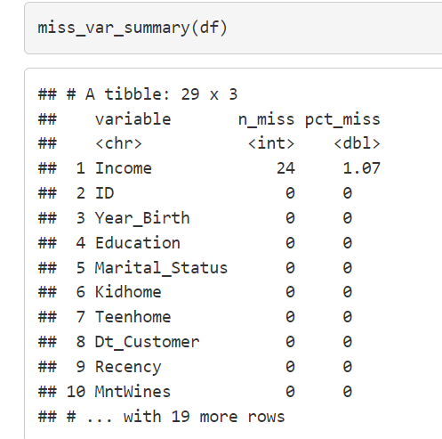
Data Cleaning
There are two parts in data cleaning: missing data and outlier detection
For missing data:
The only variable with missing data problem is income.
drop the customer data point with missing data

Slide 6
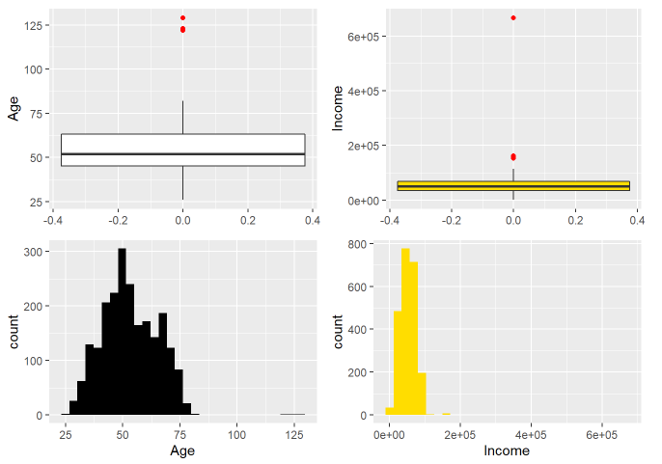
Data Cleaning
Create new features Age with Year_Birth, it will be more informative
Detecting outliers:
Using filter function to ignore income>600,000 and age>90

Slide 7
Data Cleaning
Some data transformation:
Collapsing Education into 2 categories: Graduate and Non-graduate(5->2)
Collapsing Marital_Status into 2 categories: single and taken(7->2)
Converting above to factor variables
Creating kids combining Kidhome and Teenhome
Creating Total_spent and Total_num by adding up all bought product amount and counting up the purchasing via different platform
Changing some variables name such as Mntwines->wines; Mntmeat->meat;
Deleting some redundant features such as Year_Birth, Dt_Customer…

Slide 8
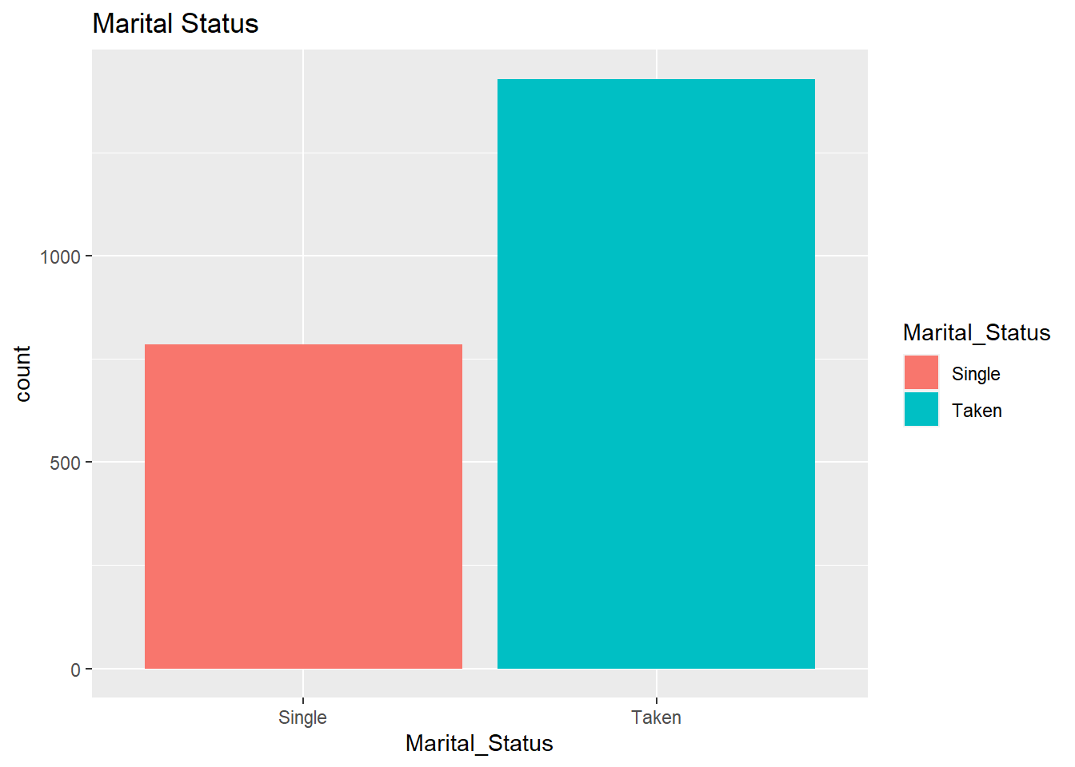
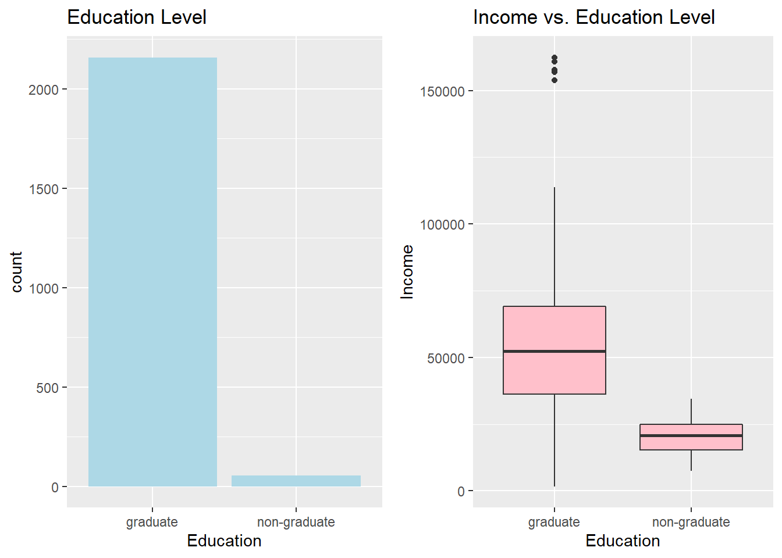
EDA
We do some initial research in with histogram and scatter plots in this parts

Slide 9
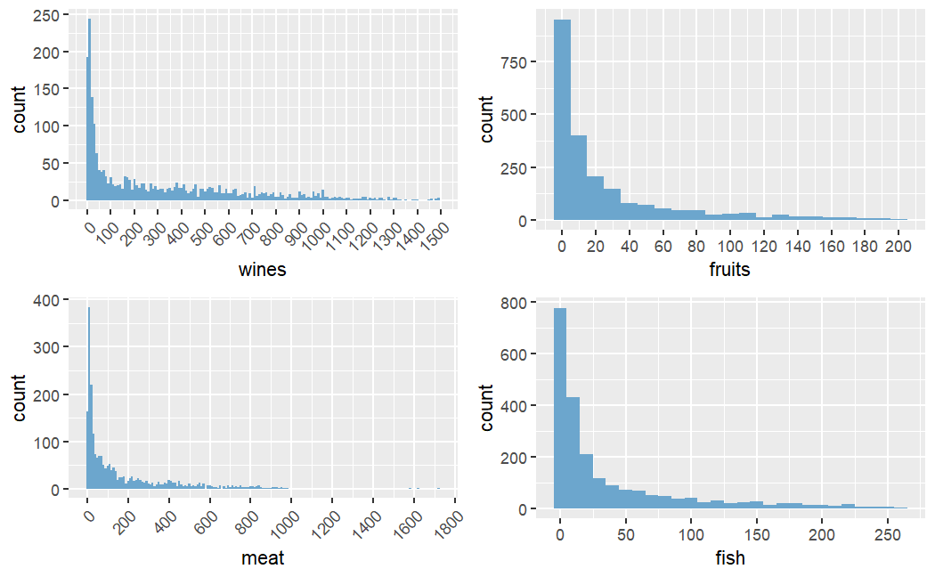
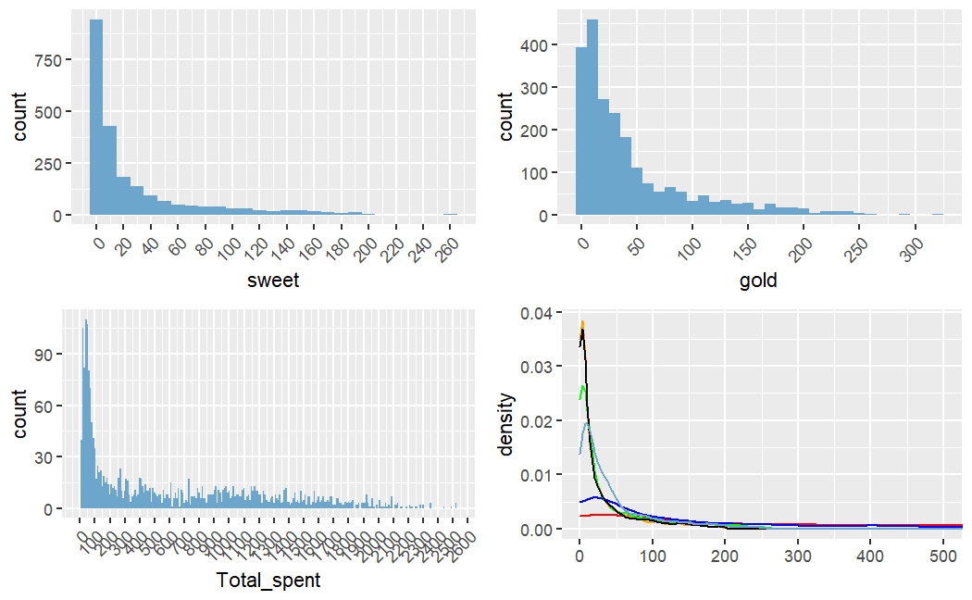
EDA

Slide 10
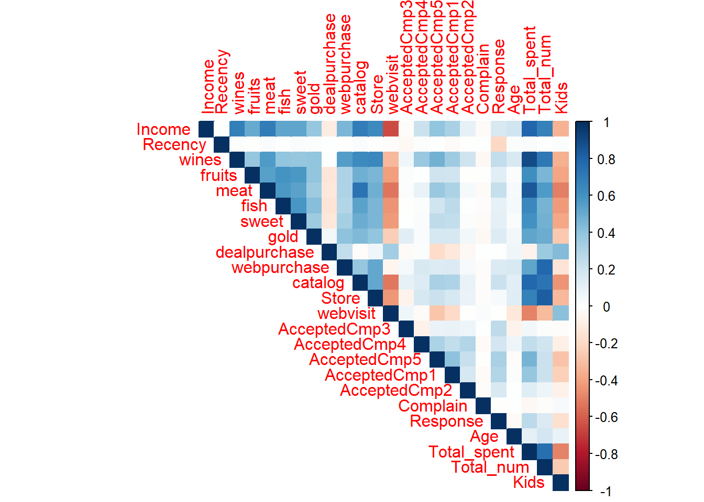
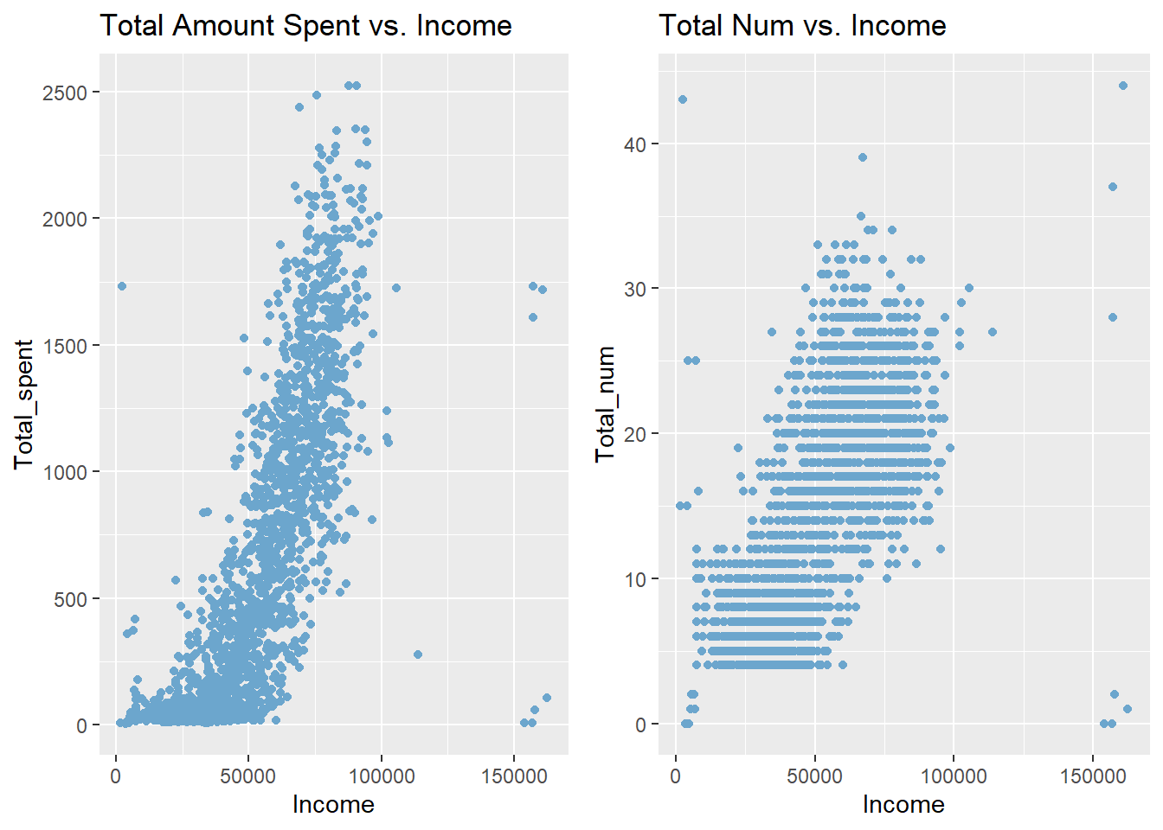
EDA

Slide 11
Segmentation
We use PCA as the segmentation method in this part, it is an unsupervised learning method.
Firstly, we need to standardize some of the features for PCA
Centering and Scaling
We anticipate to have 2 or 3 specific customer groups for the results

Slide 12
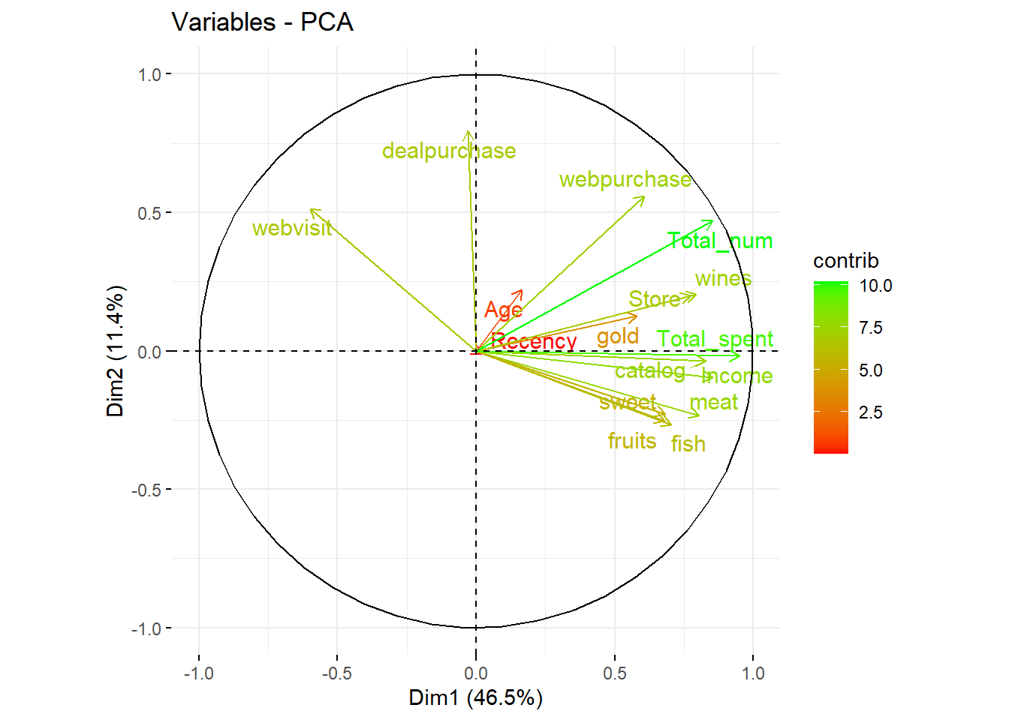
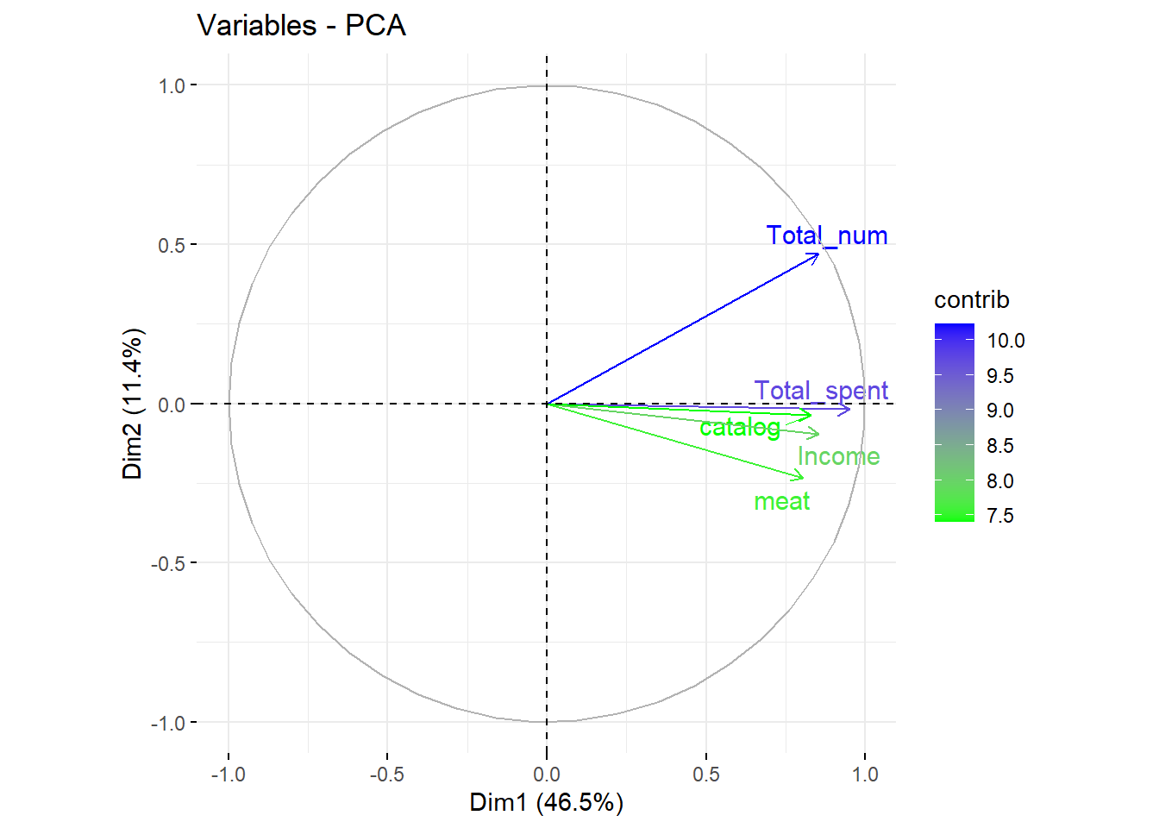
PCA

Slide 13
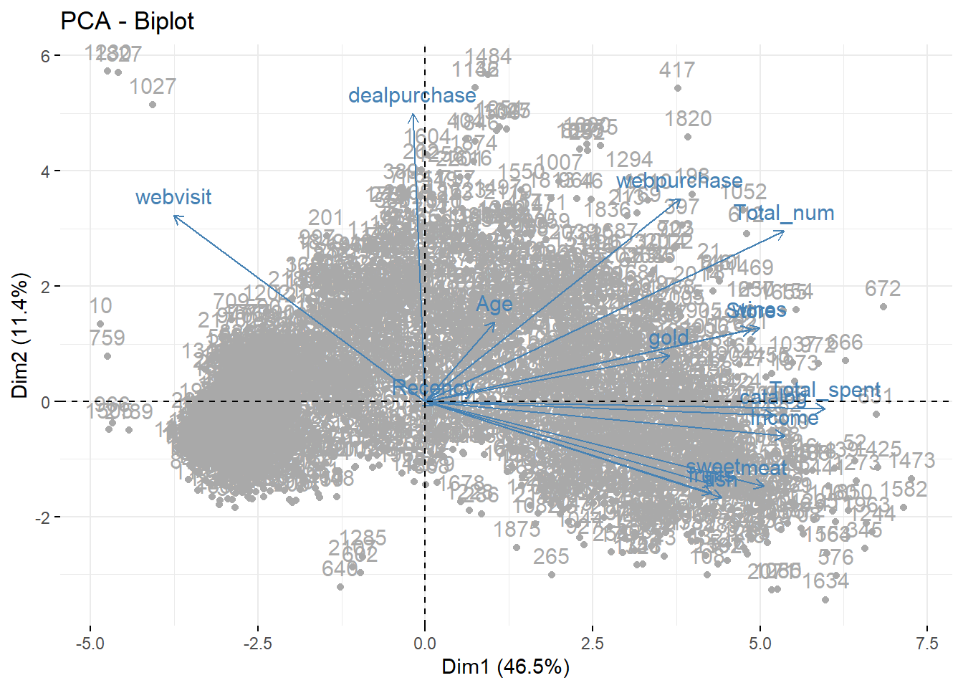
PCA

Slide 14
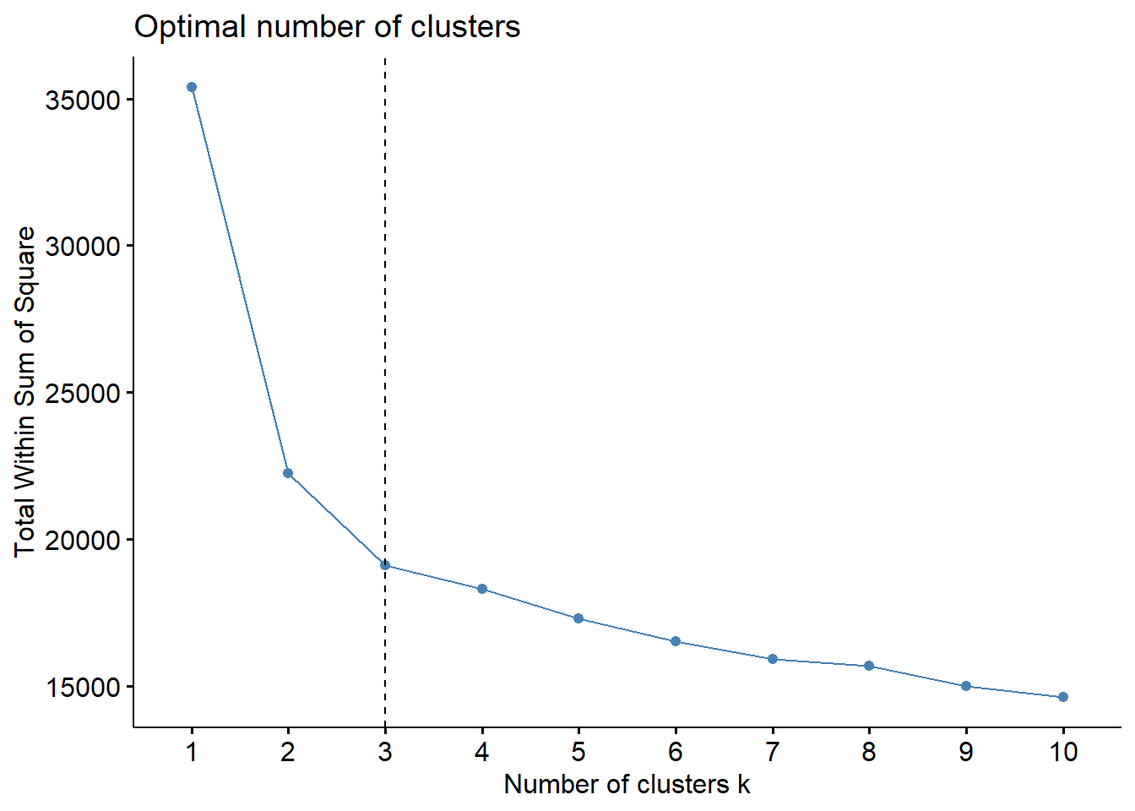
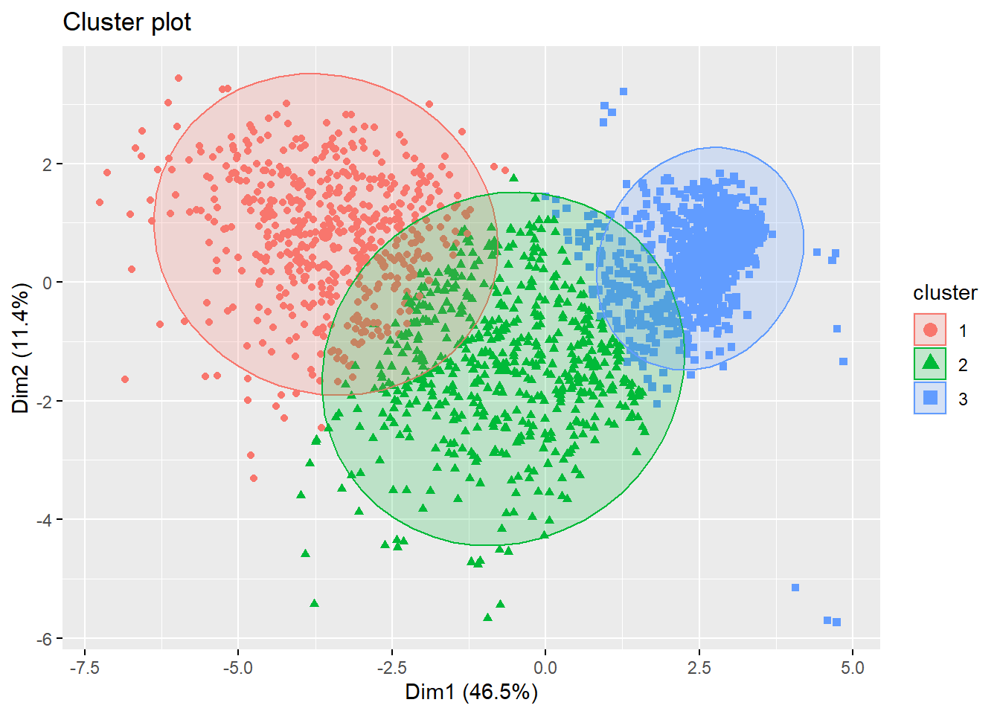
PCA

Slide 15
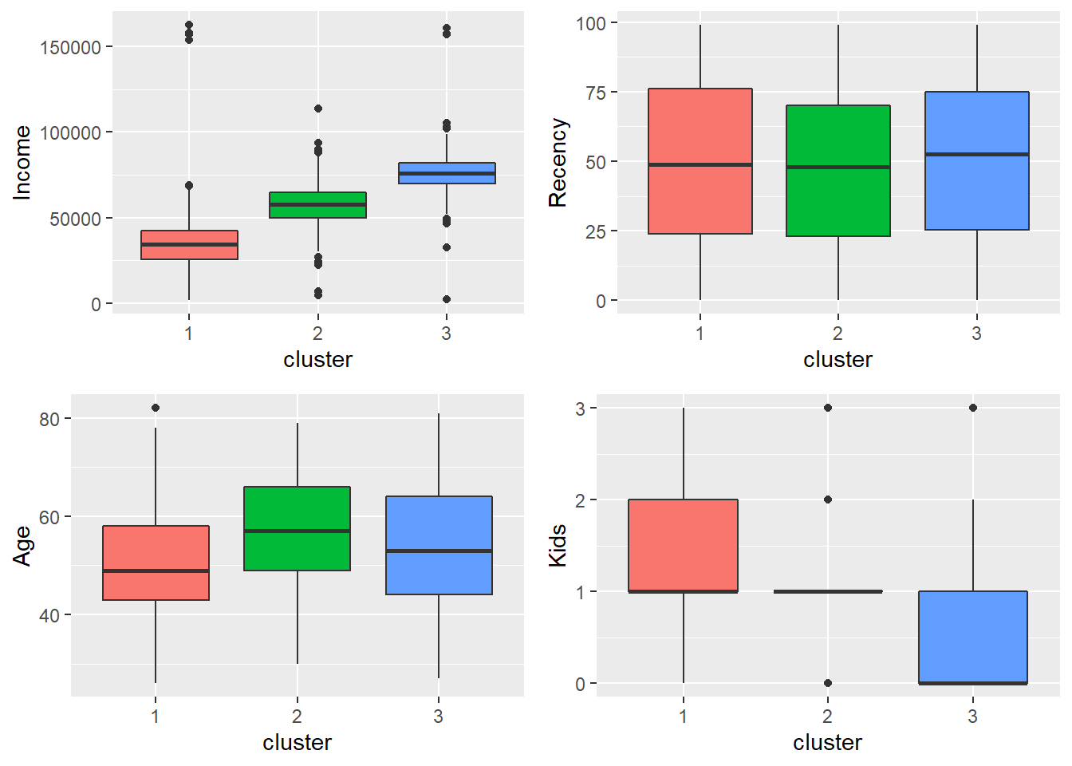
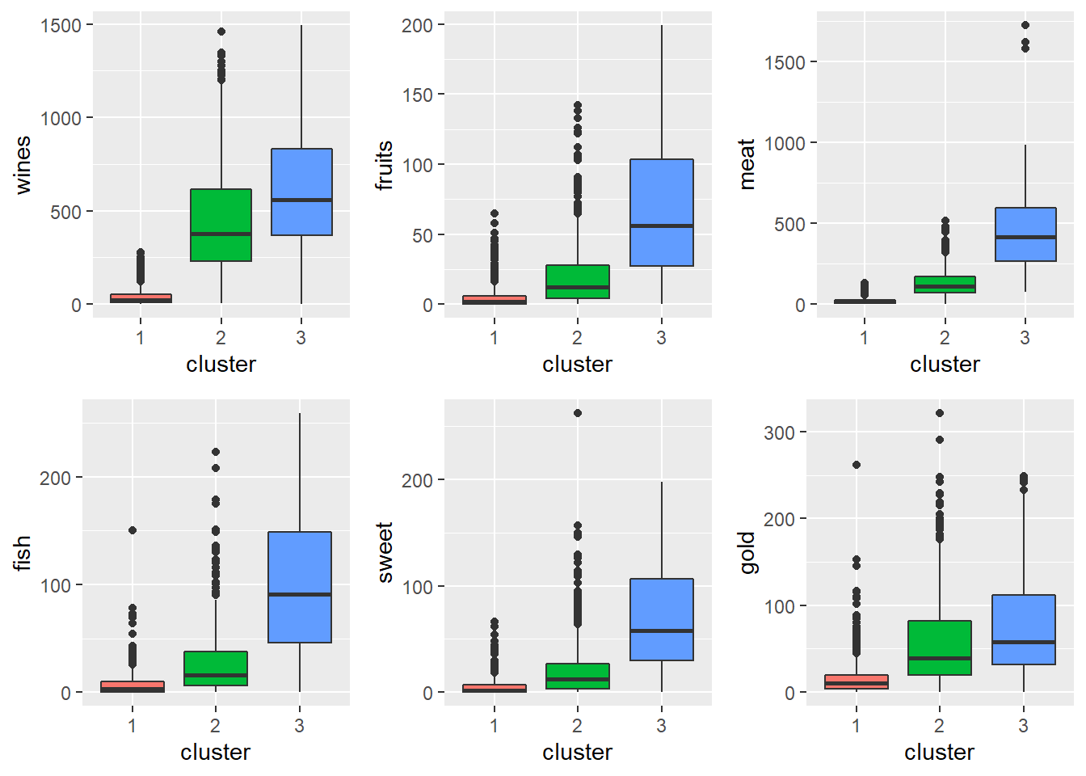
Segmenting results

Slide 16
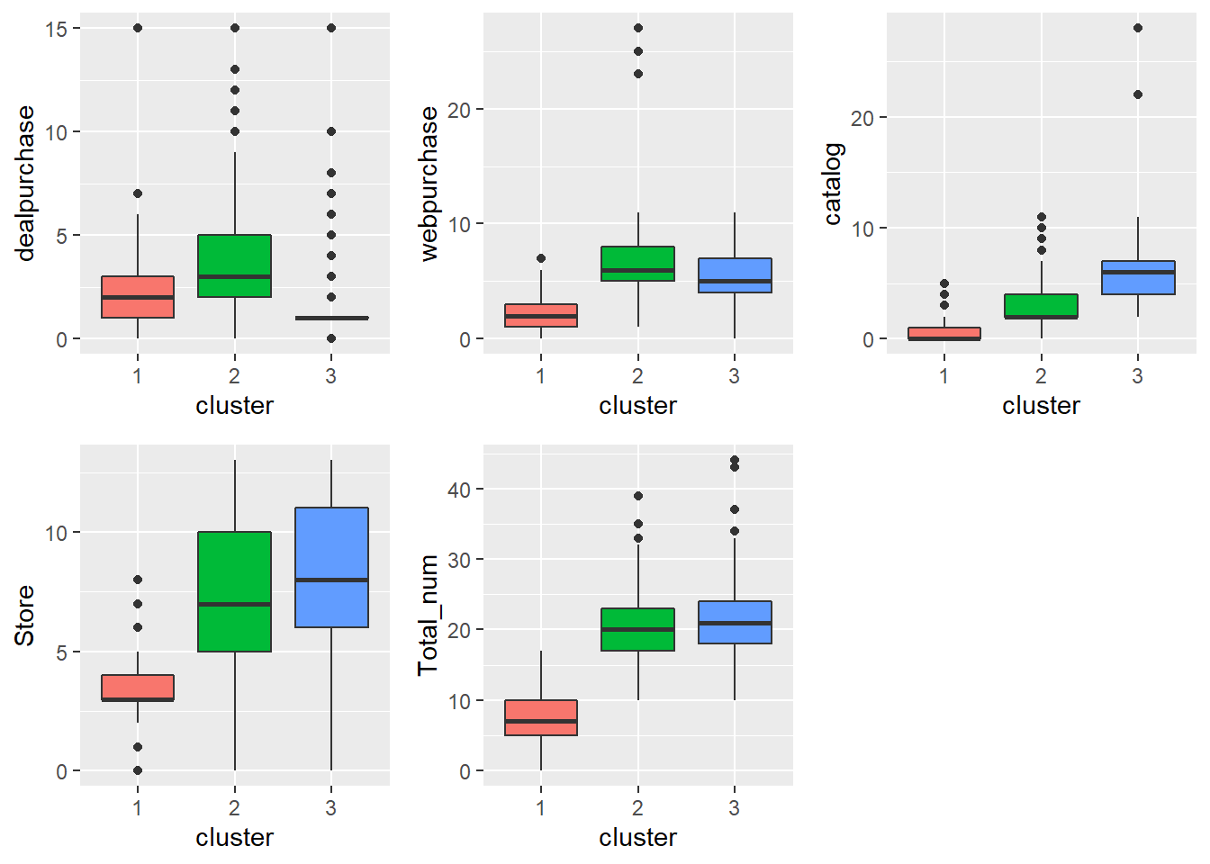
Segmenting results
Conclusion:
Cluster 1:
Low purchasing power customer
No wine/meat
More recency
Cluster 2:
prefer deal/web
Cluster 3:
High purchasing power
Prefer catalog/store
Purchasing more product

